Slide 1
Predicting Term Deposits
21-10-2022
Sakshi Chadha

Slide 2


S A K S H I C H A D H A
Masters in Screen Production Bachelors in Journalism People Manager Aspiring Data Analyst

Slide 3
M A R K E T I N G A N A L Y T I C S
Marketing: Activities to promote sales
Marketing + Strategic Planning = Campaign
Stages of a campaign:
Create awareness
Customer Interest —> Product Consideration
Customer Decision
Sale!

Slide 4
CLIENT: Portuguese Bank
BUSINESS QUESTION: How can we better target term deposit clients to reduce campaign cost and maximise profit?
STAKEHOLDER: Bank Campaign or Marketing Manager

Slide 5
DATA QUESTION: Can we predict/identify customers who are very likely to make a term deposit for successful lead generation?

Slide 6
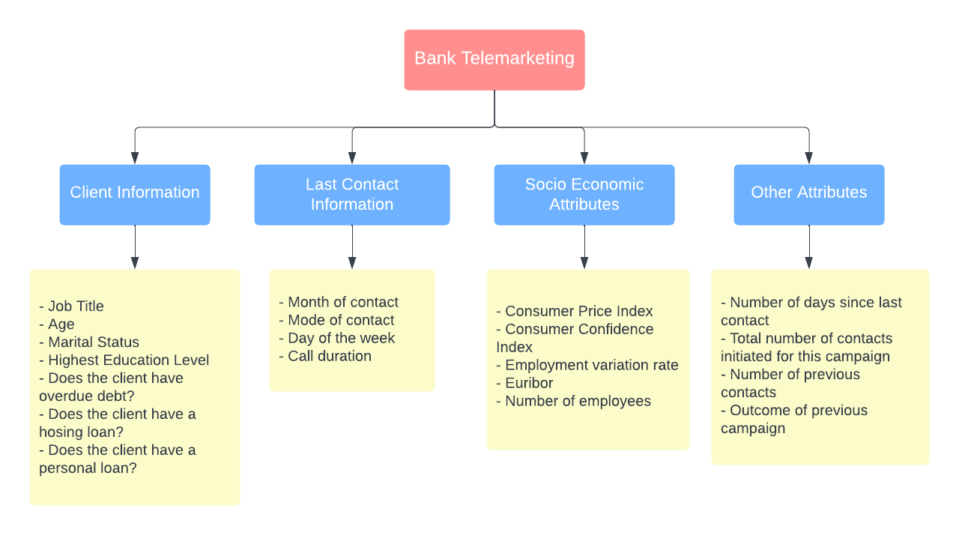
Source: UCI | Entries: 41,188 | Feature Columns: 22 | Target Column: Term deposit (Yes/No)

Slide 7

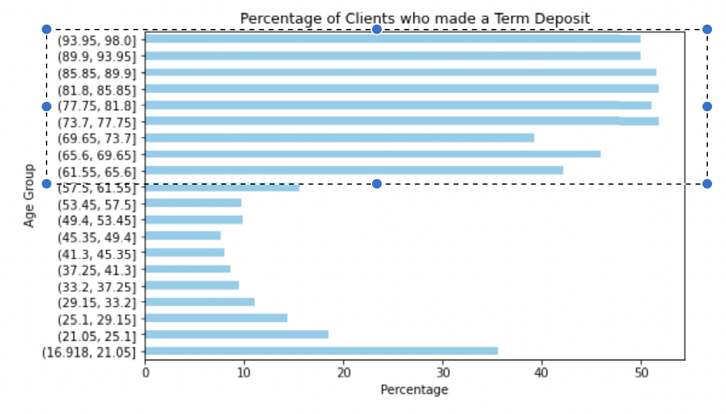
Exploratory Data Analysis: AGE

Slide 8
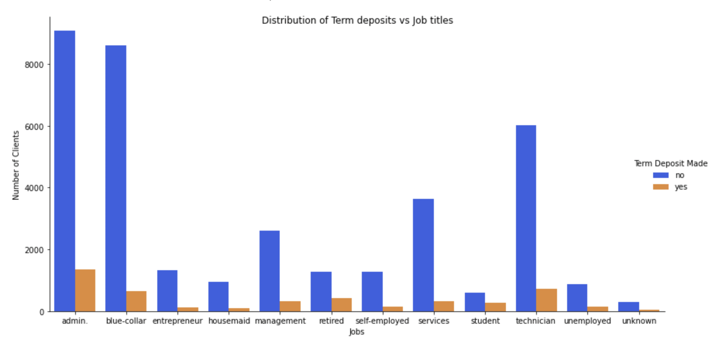
JOB Distribution

Slide 9
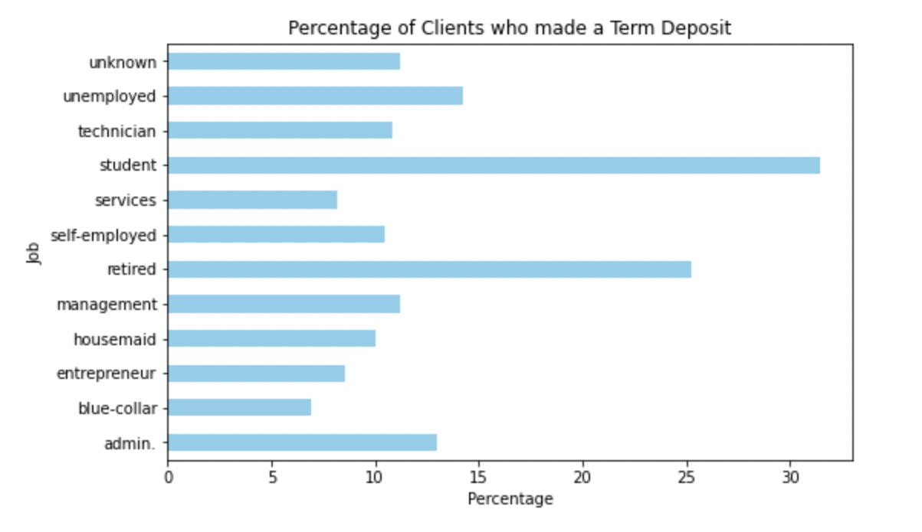
30%
25%

Slide 10
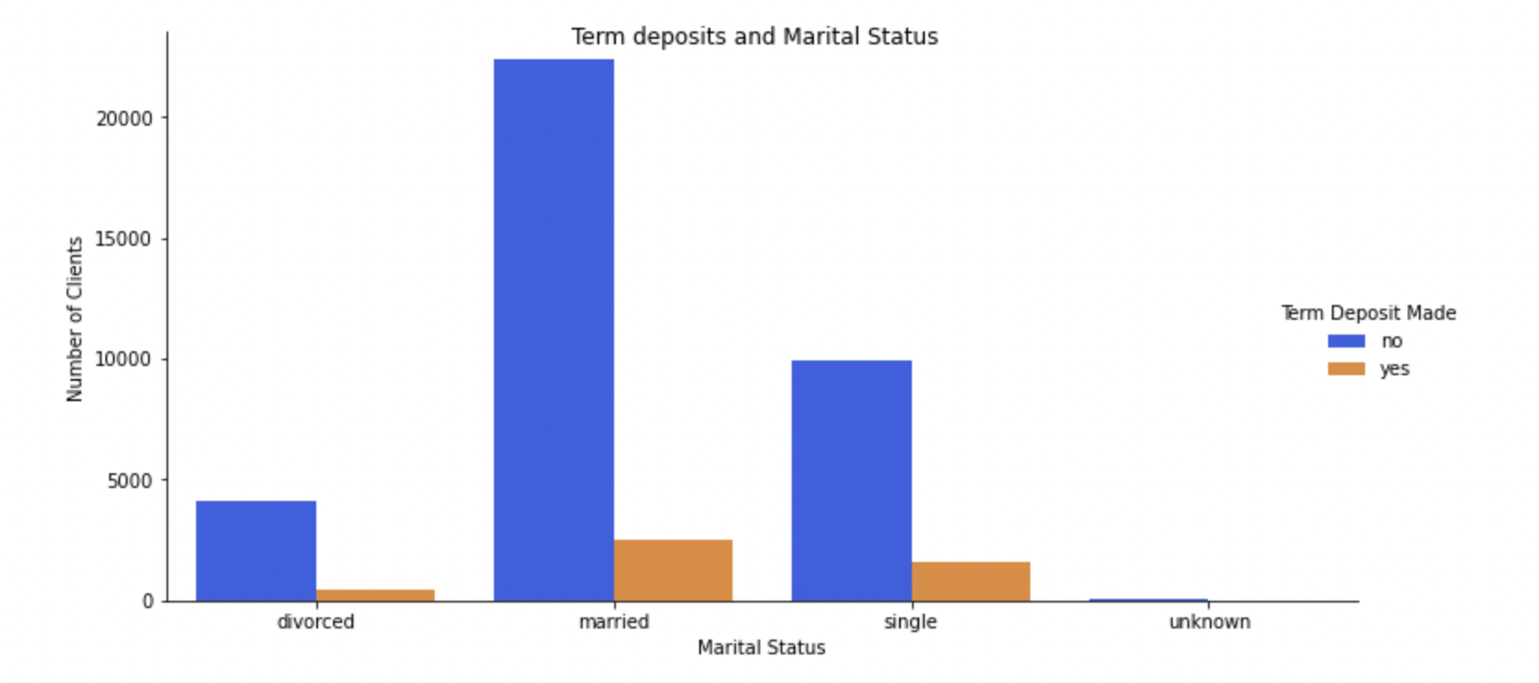
Marital Status

Slide 11

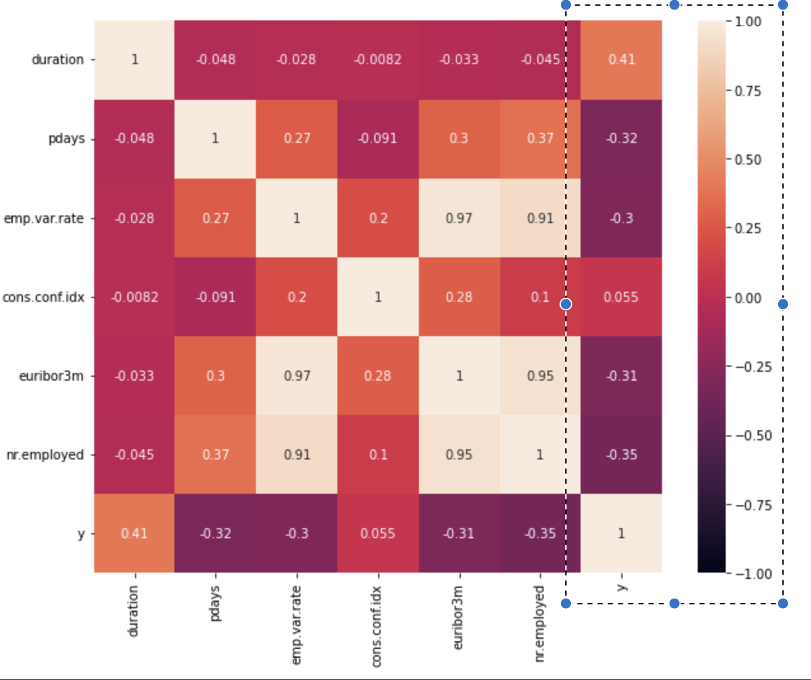

Slide 12
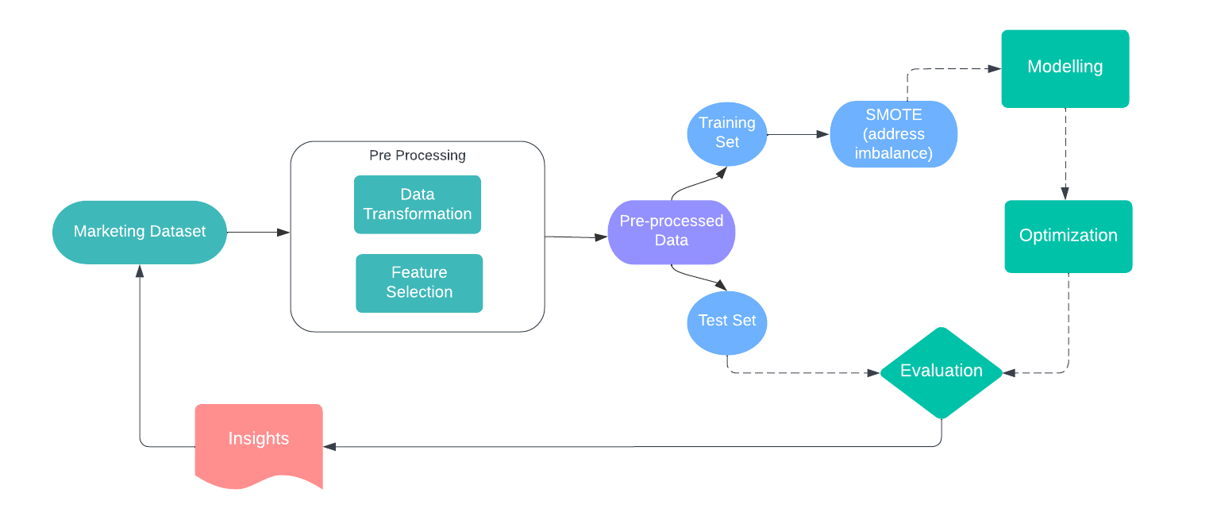
Data Science Pipeline

Slide 13
ML Model | Training Set Accuracy | Test Set Accuracy | Area Under Curve
Decision Tree | 77.3% | 85.2% | 0.746
Bagging (Decision Tree) | 74.0% | 83.3% | 0.793
Adaboost (Decision Tree) | 74.6% | 84.9% | 0.790
XGBoost | 76.9% | 85.4% | 0.789

Slide 14
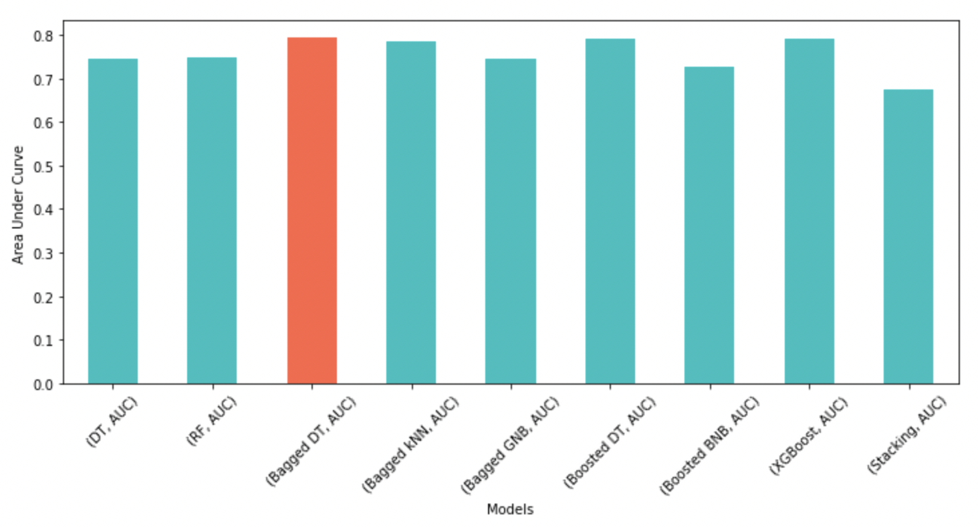
Evaluation Metric: AUC
AUC Comparison

Slide 15
Important Features
Client Information | Socio Economic Factors
Day of week | Number of Employees
Default | Euribor
Age | Employment Variation Rate

Slide 16


Recommendations
Extreme Gradient Boosting
Minimise Operational Cost

Slide 17
Next Steps:
Feature Engineering
Hyper tuning NN’s.

Slide 18
Any Questions?

